Slide 1
GEOG0113 Lecture 006 Terrestrial Ecosystem Modelling
H. Heorton
UCL Geography
& NERC NCEO

Slide 2
Aims of lecture
In this lecture, we will consider:
Land surface schemes
Third-generation LSMs

Slide 3
Some history …
See Ryu et all. (2019) What is global photosynthesis? History, uncertainties and opportunities
De Wit (1970) “Seven- stage simulation models by means of which eco-systems may be explained on basis of the molecular sciences are impossible large and detailed and it is naive to pursue their construction.” GIGO?
Global photosynthesis sets the limit of the planetary boundary of production
Photosynthesis is the essential driver of the global carbon cycle, strongly coupled with the climate system via numerous feedback processes
Larger year-to-year variations of global land carbon sinks compared to the ocean … suggest that global land photosynthesis must be quantified accurately.
Crop yields and wood production …. depend on photosynthesis
Quantifying global photosynthesis requires meeting multiple grand challenges … understanding coupled and non-linear biophysical processes that span 14 orders of magnitude in space and time (!)

Slide 4
Some history …
Landmark work on modeling global photosynthesis, from Ryu et al. (2019)

Slide 5
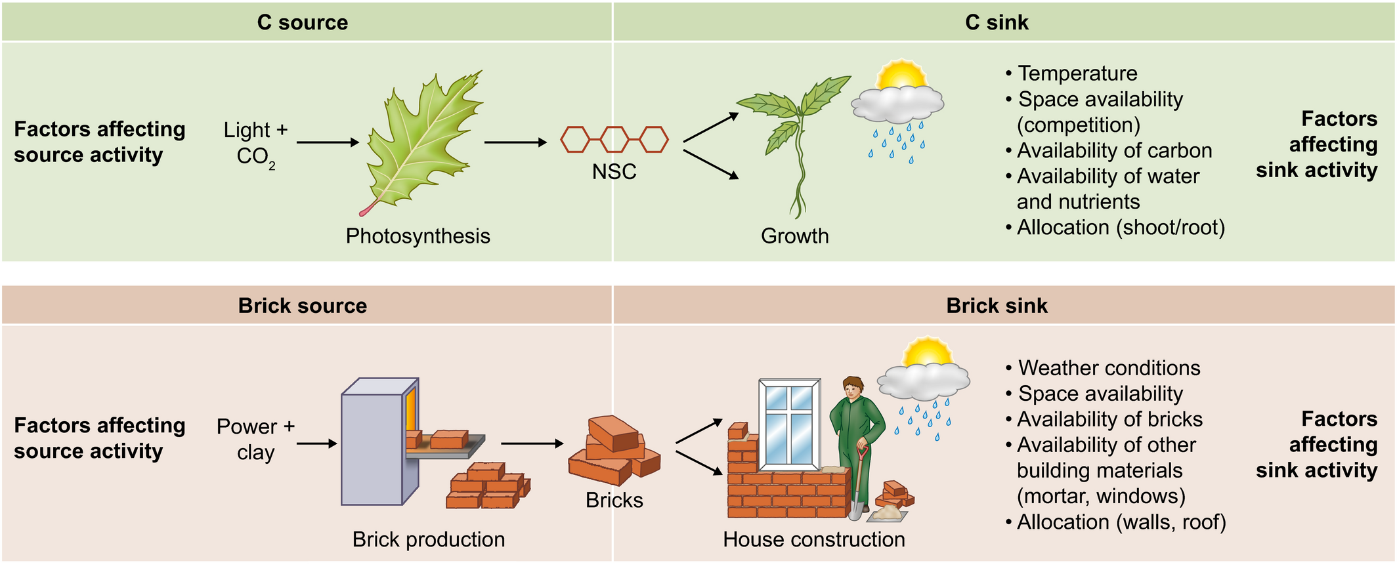
Definition - Land surface schemes
A set rules for a particular LS, (forest, savannah, urban), that allows for the quantification of exchanges and feedbacks (temperature, moisture, chemistry)
We are interested in the photosynthesis aspect of LS schemes
LS schemes, implemented as LS models
LS component of climate / earth system models
Purpose:
Model energy and (carbon, water) fluxes at land-atmosphere interface

Slide 6
Main driver: energy
Rn=S↓(1−α)+L↓−L↑
Rn = net radiation; S↓ = downwelling s/wave; α = albedo; L↓, L↑ down/upwelling longwave
terms balance globally over the long term
But short term /spatial variations drive earth system

Slide 7
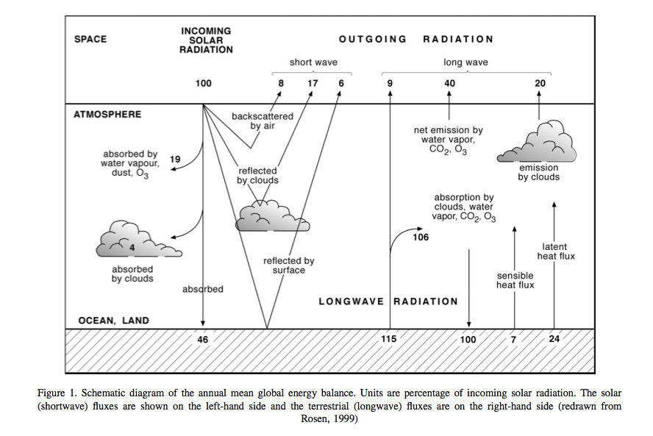
Notes:
In the above figure, showing global averages of components of the energy balance, the solar radiation is represented as 100 units. Around 31 units are exchanged as sensible and latent heat fluxes (H and λE respectively), but the properties of the land surface significantly affect the way these fluxes are partitioned. The land surface also acts to store energy on various timescales (diurnal, seasonal, and longer).

Slide 8
Balance by heat & chemical fluxes
Rn=H+λE+G+F
H = sensible heat flux; λE = latent heat flux; G = soil flux; F = chemical energy flux stored in photosynthesis
Latent heat – heat absorbed/released by change of state at constant T (eg liquid to vapour)
Sensible heat – causes solely change in T
Notes:
The net radiation Rn must be balanced by H and λE and by the soil flux G and the chemical energy flux F stored in photosynthesis:

Slide 9
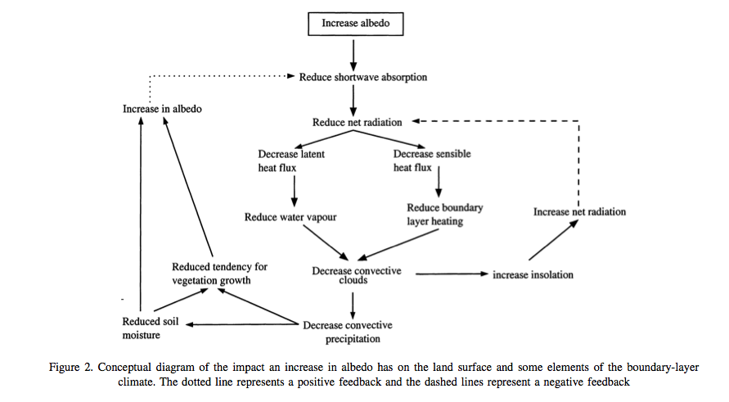
Notes:
We can already see from these equations that changes in e.g. albedo α are likely to alter H and λE by altering Rn.

Slide 10

Changing albedo

Slide 11
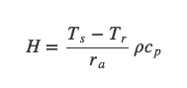
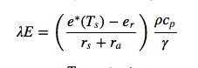
Partitioning latent & sensible heat
Partitioning important as controls flux of water vapour to the atmosphere
Influence on cloudiness, rain
H and λE are turbulent heat fluxes
T_{s} = surface T; T_{r} = ref. temp. above surface; r_{a} = aerodynamic resistance; ρ = density of air; c_{p} = specific heat of air. e*(Ts) is saturated vapour pressure at Ts; e_{r} = vapour pressure at ref height; γ = psychometric constant (relates partial pressure of water in air to air temp); r_{s} = bulk surface resistance to transfer of water to air.
Notes:
where Ts is the surface temperature, Tr is a reference temperature above the surface, ra is the aerodynamic resistance , ρ is the density of air, and cp is the specific heat of air.
where e∗(Ts) is the saturated vapour pressure at Ts, er is the vapour pressure at a reference height, γ is the psychrometric constant and rs is the bulk surface resistance to the transfer of water from the surface to the air.

Slide 12
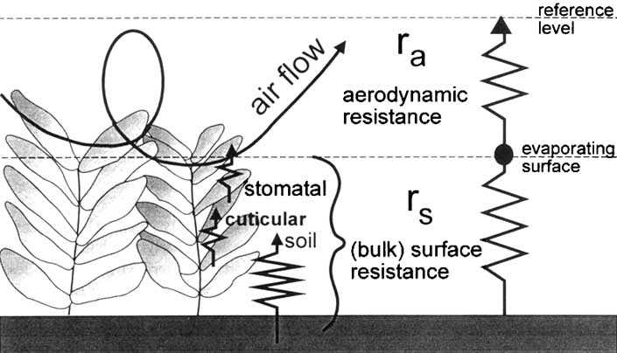
surface and aerodynamic resistances for water vapour flow

Slide 13
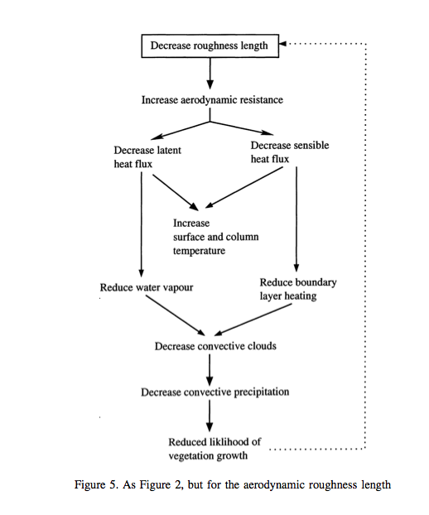
Roughness length depends on vegetation height
Removal of vegetation can have feedback effect

Slide 14
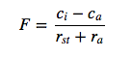
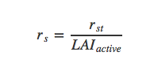
Other fluxes
Turbulence also affects other fluxes e.g. CO2
So we can relate internal and ambient CO2 to stomatal and aerodynamic resistance
Approx.
Notes:
where F is the the CO2 flux density (kgm−2s−1), ci is the internal leaf CO2 concentration, and ca is the ambient CO2 concentration. Here, rst is the stomatal resistance (see below), a measure of the difficulty (or ease) for the vegetation to transpire.
The stomatal resistance is not the same as the bulk surface resistance rs above as rs includes the resistance to moisture transfer from the soil and leaf surface. For a crop or grassland, the bulk surface resistance can be estimated as rs = rst / LAI_active where LAIactive is the active (sunlit) leaf area index, and rst is the ‘bulk’ stomatal resistance of a well-illuminated leaf. Note that this approximation does not include evaporative fluxes from the leaf surface or soil however: in land surface schemes this is usually treated more carefully and involves explicit calculation of the individual resistance terms that combine to make the bulk surface resistance.

Slide 15
Water balance
P=E−Rdrain−Rsurf−ΔS
So we can relate evapotranspiration to runoff, change in soil water storage and water inputs (precip., snowmelt)
P = water input; E = evapotransp.; Rdrain = slow drainage; Rsurf = surface runoff; ΔS = change in soil moisture storage
Notes:
where P is water input to the system (precipitation and snow melt generally, but also translocation of water e.g. in irrigation), E is evapotranspiration (water from the surface to the atmosphere through evaporation from the soil and leaf surfaces and transpiration from leaves), Rdrain is a slow drainage component of water loss from an area, Rsurf is surface runoff, and ΔS is the change in soil moisture storage.

Slide 16
Land Surface Model
Models energy and water fluxes (++) at the land surface
provides an interface of these to atmospheric modelling.
Usually, this will be done for a set of grid cells, where inputs and outputs of each cell are considered separately
Lateral transport of water (e.g. snow, river)

Slide 17
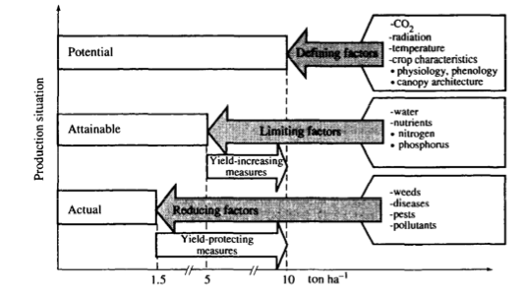
Basic vegetation growth
Notes:
A set of defining factors (plant type, CO2, radiation, etc.) describe how the vegetation would grow under conditions where it is not limited by water and nutrient constraint. It will of course respond to variations in the environmental conditions (CO2, radiation, temperature). This provides a model of the potential growth of the vegetation under these conditions. The attainable growth then is the potential growth modulated by some limiting factors such as water or nutrient availabiliy. The actual growth then has some further modulation by pest, disease etc. or when considering carbon stocks perhaps other reducing factors such as grazing.

Slide 18
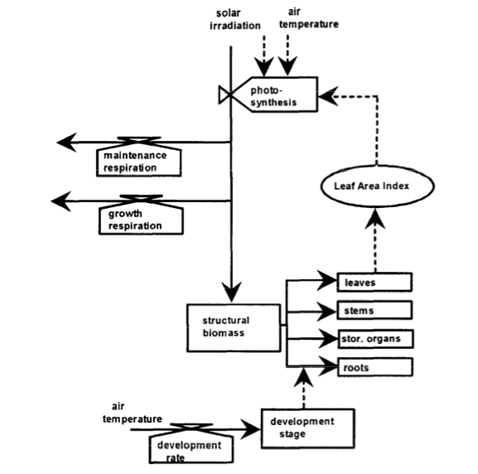

Structure of most models similar
Notes:
The main state variable here is the pool of structural biomass, which is also represented as a set of pools in different plant organs (leaves, stems, roots and storage organs). The fundamental process within such a model then is the production of this pool of stuctural biomass and its allocation to organ pools. The other state variable here is the development stage which strongly affects the allocation rate from the ‘structural biomass’ pool to the different organs. It also impacts plant structure although this is not generally explicitly considered in such models.
The biogeochemical processes represented here are photosynthesis, respiration (maintenance and growth) and the development rate which controls the ‘stage of development’ of the crop. Note that only states and processes directly involving the plant are considered in such a crop growth model (i.e. we do not consider what happens to/in the soil).

Slide 19
Some land surface schemes: Third generation LSMs
1990s+
Advance LSM by connecting leaf stomatal conductance and carbon assimilation
Farquhar et al. (1980) and Farquhar and von Caemmerer (1982)
Can dynamically model vegetation
Examine climate feedbacks

Slide 20
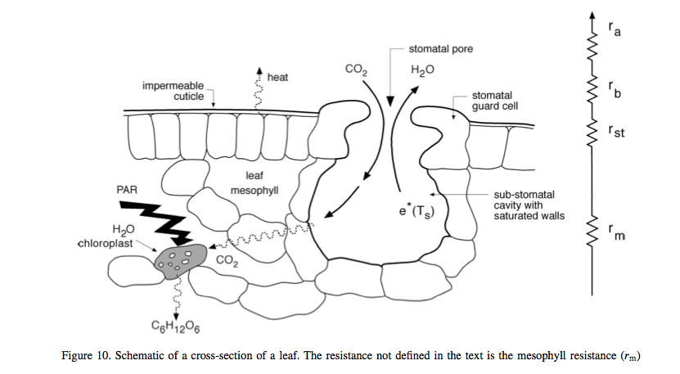
Notes:
essentials of the method are some semi-mechanistic model of stomatal conductance from the net leaf assimilation rate An and the calculation of A_n a as the minimum of potential assimilation under different limitations with leaf respiration subtracted (deal with in detail below)

Slide 21
Summary
outlined the main processes in land surface schemes and models and highlighted the interplay of radiation and water.
introduced some core concepts in vegetation processes
vegetation growth can be modelled as a potential amount of carbon assimilation that is then limited by factors such as water and nutrient availability as well as being reduced by pests, disease etc.
Looked at some features of 3rd generation LSMs
Include carbon

Slide 22
Recommended Reading
Ryu et al. (2019) What is global photosynthesis? History, uncertainties and opportunities, Rem. Sens. Environ., 223, 95-114.
Fatichi et al., 2018, Modelling carbon sources and sinks in terrestrial vegetation https://doi.org/10.1111/nph.15451
Fisher, J.B. Deborah N. Huntzinger, Christopher R. Schwalm, Stephen Sitch, Modeling the Terrestrial Biosphere, Annual Review of Environment and Resources 2014 39:1, 91-123
Bouman, B.A.M. ; van Keulen, H. ; van Laar, H.H. ; Rabbinge, R. (1996) The School of de Wit crop growth simulation models: A pedigree and historical overview, Agricultural Systems, 1996, Vol.52(2), p.171-198
Sellers PJ. 1992. Biophysical models of land surface processes. In Climate System Modelling, Trenberth KE (ed.). Cambridge University Press.
D. B. Clark, L. M. Mercado, S. Sitch, C. D. Jones, N. Gedney, M. J. Best, M. Pryor, G. G. Rooney, R. L. H. Essery, E. Blyth, O. Boucher, R. J. Harding, C. Huntingford, and P. M. Cox (2011) The Joint UK Land Environment Simulator (JULES), model description: Part 2: Carbon fluxes and vegetation dynamics, Geosci. Model Dev., 4, 701-722, 2011, doi:10.5194/gmd-4-701-2011
Pitman, A.J, (2003) The Evolution Of, And Revolution In, Land Surface Schemes Designed For Climate Models,, Int. J. Climatol. 23: 479-510 (2003)
Quaife, T., S. Quegan, M. Disney, P. Lewis, M. Lomas, and F. I. Woodward (2008), Impact of land cover uncertainties on estimates of biospheric carbon fluxes, Global Biogeochem. Cycles, 22, GB4016, doi:10.1029/2007GB003097.

